Slide 1
Lipids FA
SWBAT explain the structure and function of the different types of lipids.

Slide 2
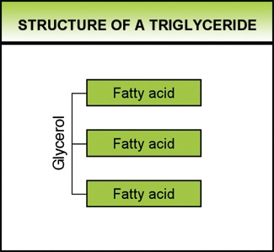
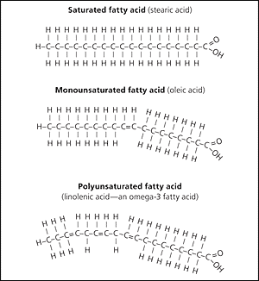
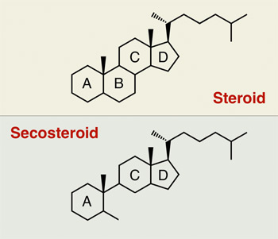
Which of the following is an example of a type of triglyceride?
A fat containing 3 saturated fatty acids
A fat containing 2 saturated fatty acids & 1 unsaturated fatty acid
A fat containing 3 unsaturated fatty acids
All of the above
eufic.org aafp.org mpkb.org

Slide 3
2 Which of the following types of fats (triglycerides) would be an oil at room temperature and would be healthier to eat since its bent carbon & hydrogen chains and don’t stack well?
Unsaturated fat WITHOUT any C to C double bonds
Saturated fat WITHOUT any C to C double bonds
Unsaturated fat containing C=C
Saturated fat containing C=C
Steroids like testosterone hormone or cholesterol
eufic.org aafp.org mpkb.org

Slide 4
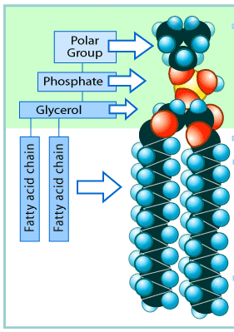
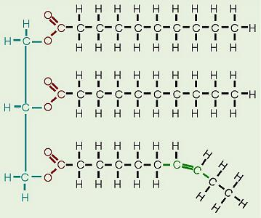
3 Which type of lipid makes up the majority of the cell membrane?
phospholipids
waxes
steroids
triglycerides
essortment.com alevelnotes.com

Slide 5
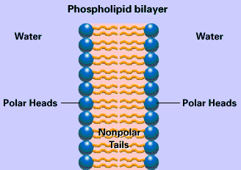
4 Phospholipids contain:
A hydrophobic polar phosphate head & 2 hydrophilic nonpolar fatty acid tails
A hydrophilic polar phosphate head & 2 hydrophobic nonpolar fatty acid tails
http://myhome.sunyocc.edu/~weiskirl/Alcamo_membrane.gif

Slide 6
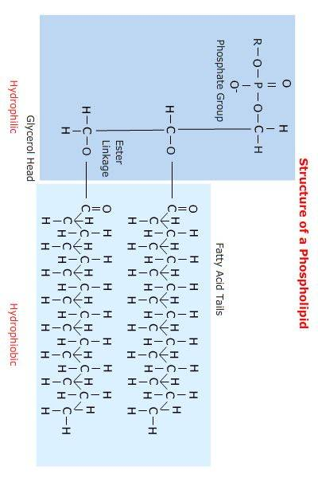
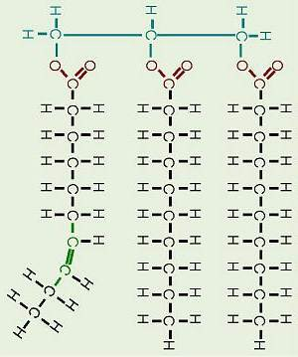
5 Which is an example of a steroid?
Structure of triglycerides: fats & oils
Fatty acids
Sex hormones
Phospholipids
Olive Oil
Triglycerides
Structure of sex hormones

Slide 7
6 What is the function of a triglyceride?
Stores and transfers genetic information
Long term energy storage, as well as insulation & protection
Control the rate of reactions
Help to fight disease

Slide 8
7 What is the function of hormones such as the steroid hormones?
Communication & cooperation between cells
Short term energy storage
Structural building materials
Compose the bilayer cell membrane

Slide 9
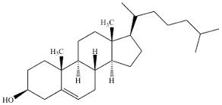
8 What is the cholesterol considered a steroid?
They have a similar hydrophobic structure
The both contain rings made mostly of Carbon and Hydrogen atoms
They are both nonpolar covalent
All of the above
cholesterol

